Slide 1
Salon 17 maart 2018

Slide 2
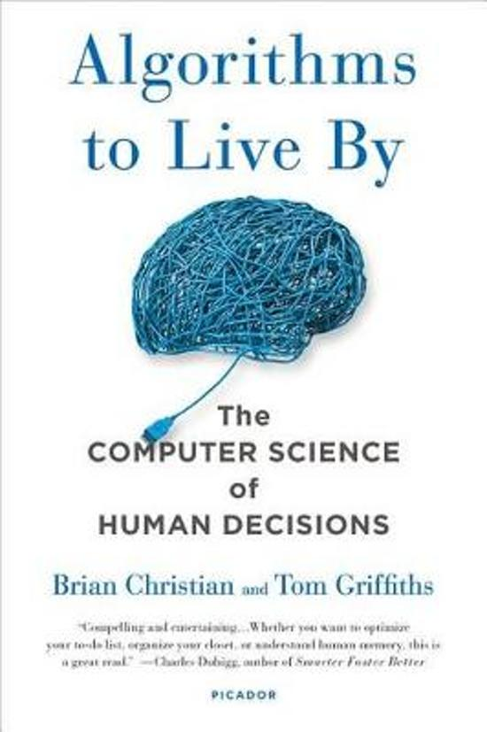

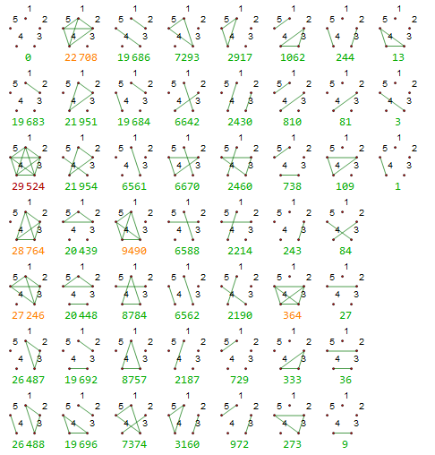
3 topics

Slide 3
Algorithms to live by
Optimal stopping
Explore/Exploit
Sorting
Caching
Scheduling
Bayes’ rule
Overfitting
Relaxation
Randomness
Networking
Game theory

Slide 4
Optimal stopping
Secretary problem
You’re interviewing a set of applicants for a secretary and your goal is to maximize hiring the single best applicant from the pool.
You can decide to offer the job to any applicant at any point and they are guaranteed to accept, terminating the search. But if you pass over an applicant, deciding not to hire them, they are gone forever.
1960 Scientific American, Martin Gardner.

Slide 5
The strategy
Look and leap
37% rule
1/E

Slide 6
Sorting
We know this : quicksort or mergesort
Pro : mergesort can be parallelized

Slide 7
Caching

Slide 9
Lotus

Slide 10
Gekko

Slide 12
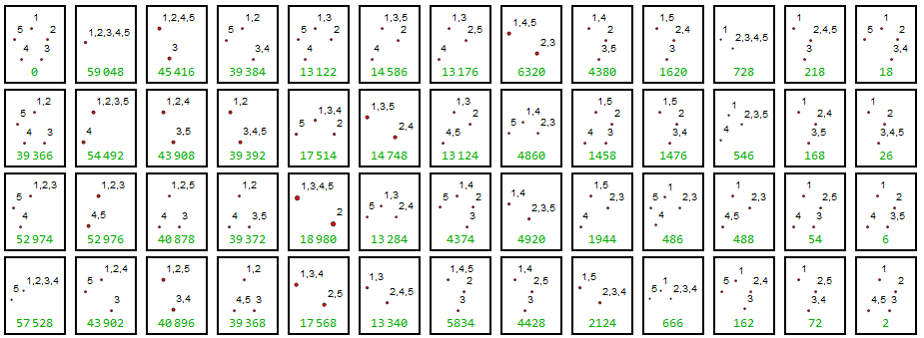
More bases : Empty

Slide 13
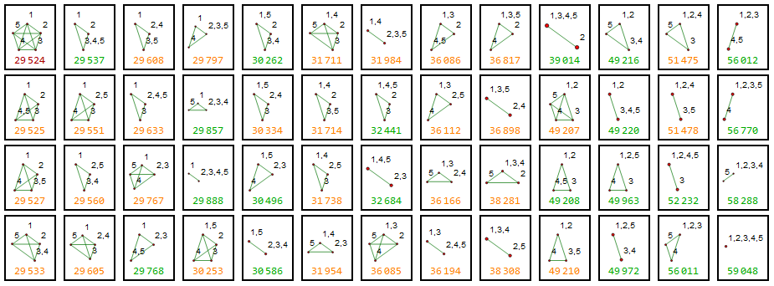
Full base

Slide 14
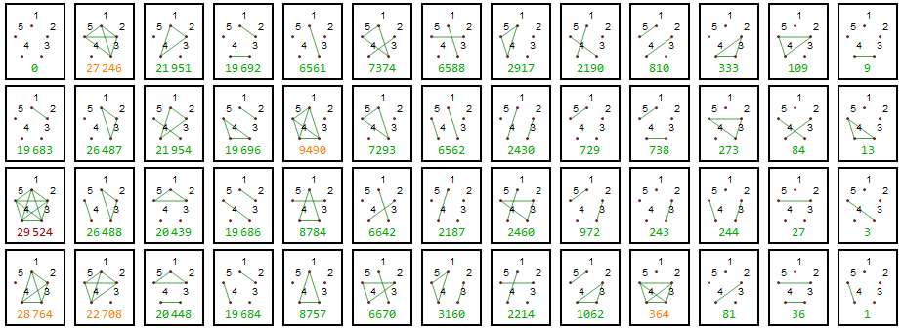
Fake

Slide 15
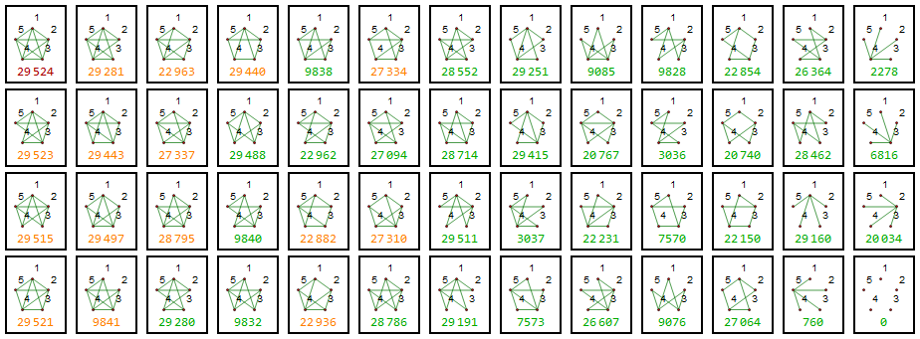
Generator base

Slide 16
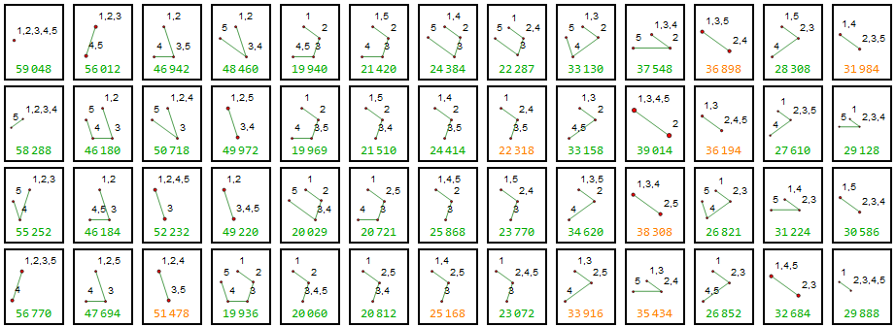
Tree

Slide 17
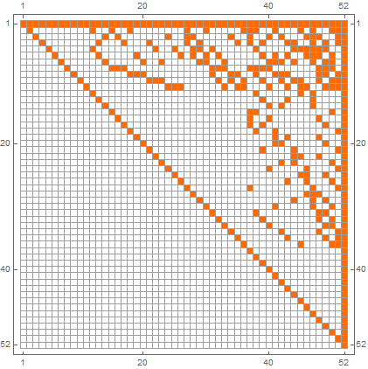
Empty to Complete

Slide 18
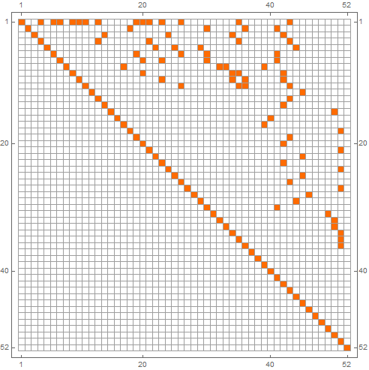
Tree to Complete

Slide 19
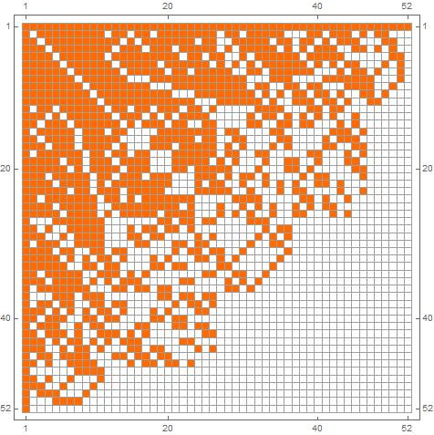
Fake to Complete

Slide 20
Generator

Slide 21
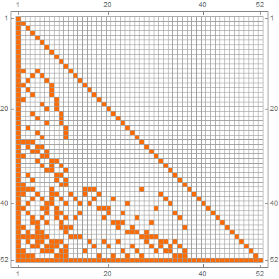
Generator to complete

Slide 22
Empty = Transpose(Generator)

Slide 23
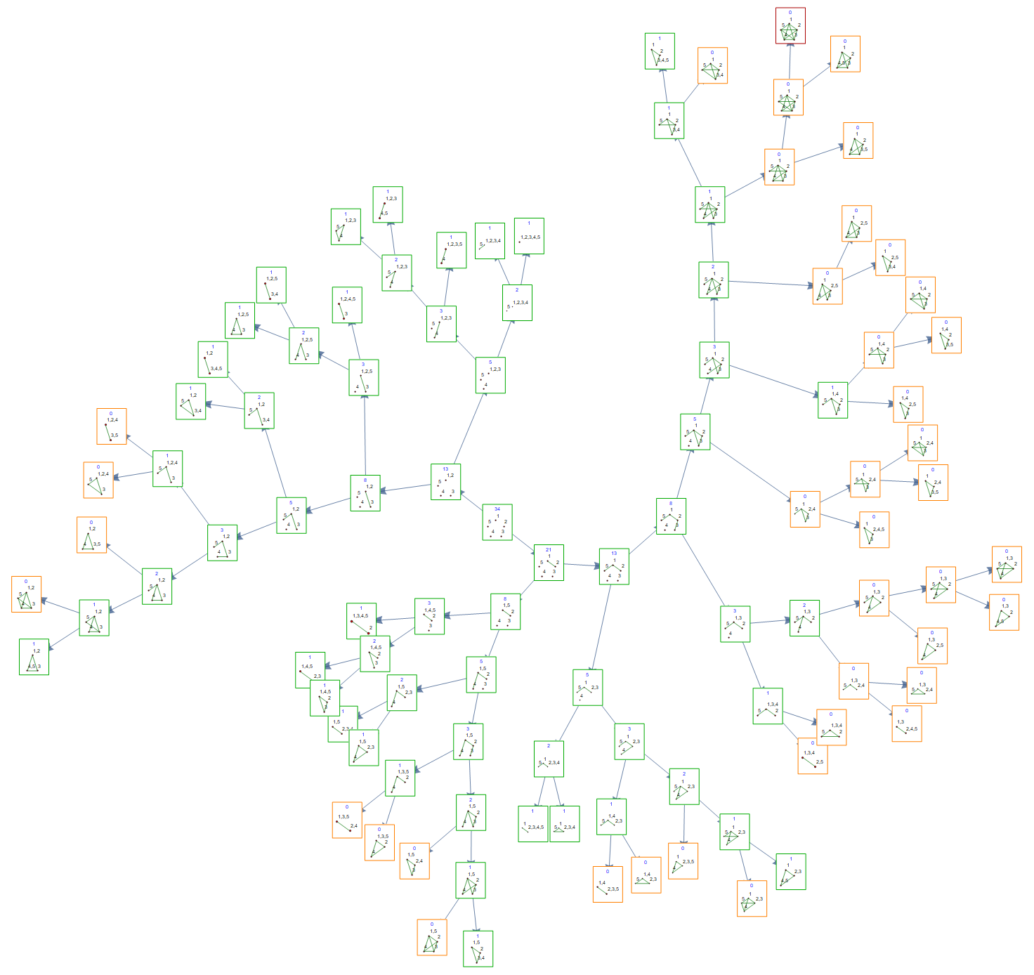
Atleast

Slide 24
